Slide 1

Eco Nest
A sustainable home décor brand

Slide 2
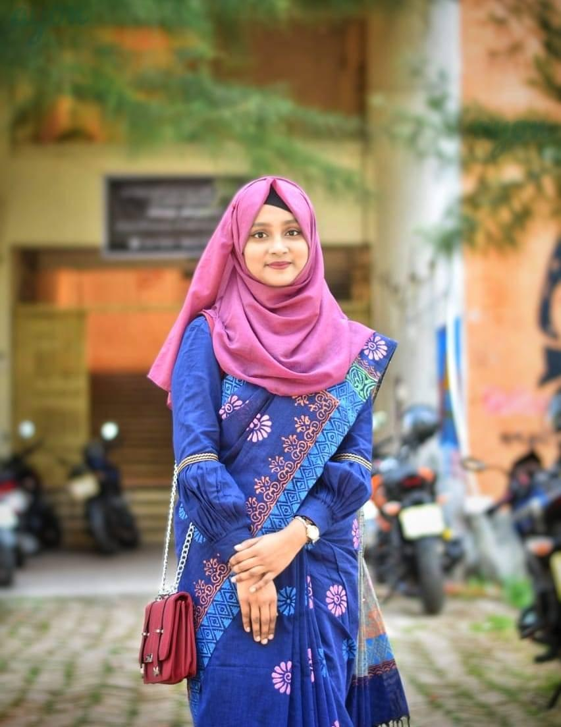
Name : Jannatul Ferdaus Mahi
Batch : 50
Date : 14-12-24

Slide 3
Company Overview
Mission
Vision
Striving to become a global leader in sustainable design and innovation
Offices
Staff
4 offices and 35 retail outlets
Over 500 professionals dedicated to innovation
To create eco-friendly home décor that enhances every living space while reducing environmental impact
Eco Nest Private Ltd.

Slide 4
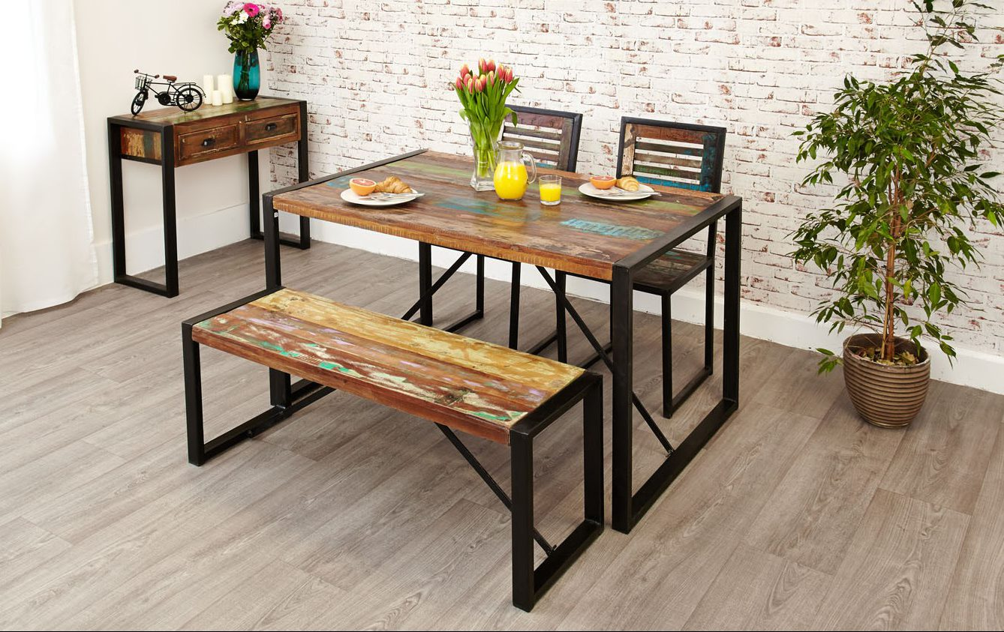
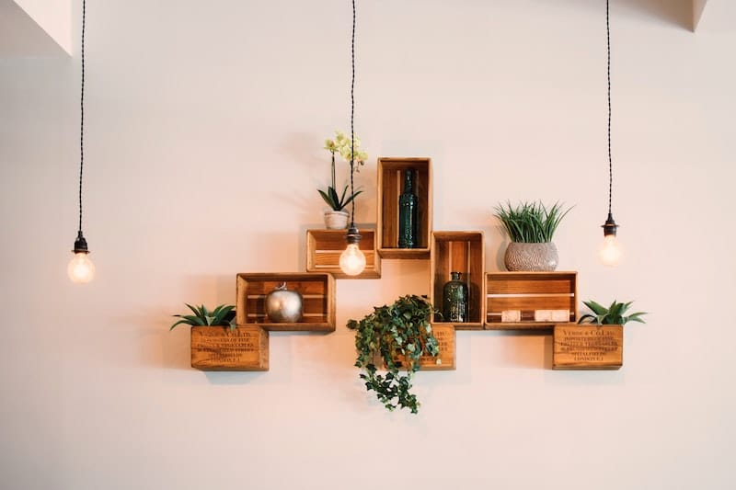
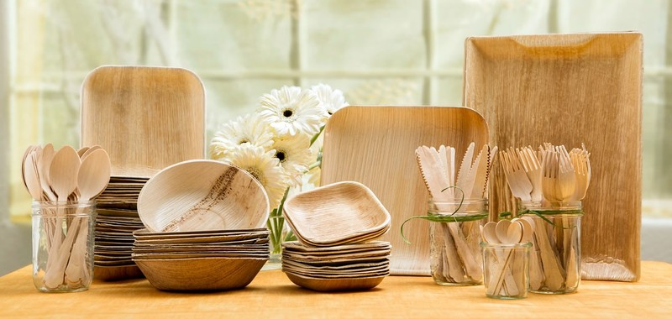
Key Products
Recycled Wooden Furniture
Eco-Friendly Décor Items
Biodegradable Kitchenware

Slide 5
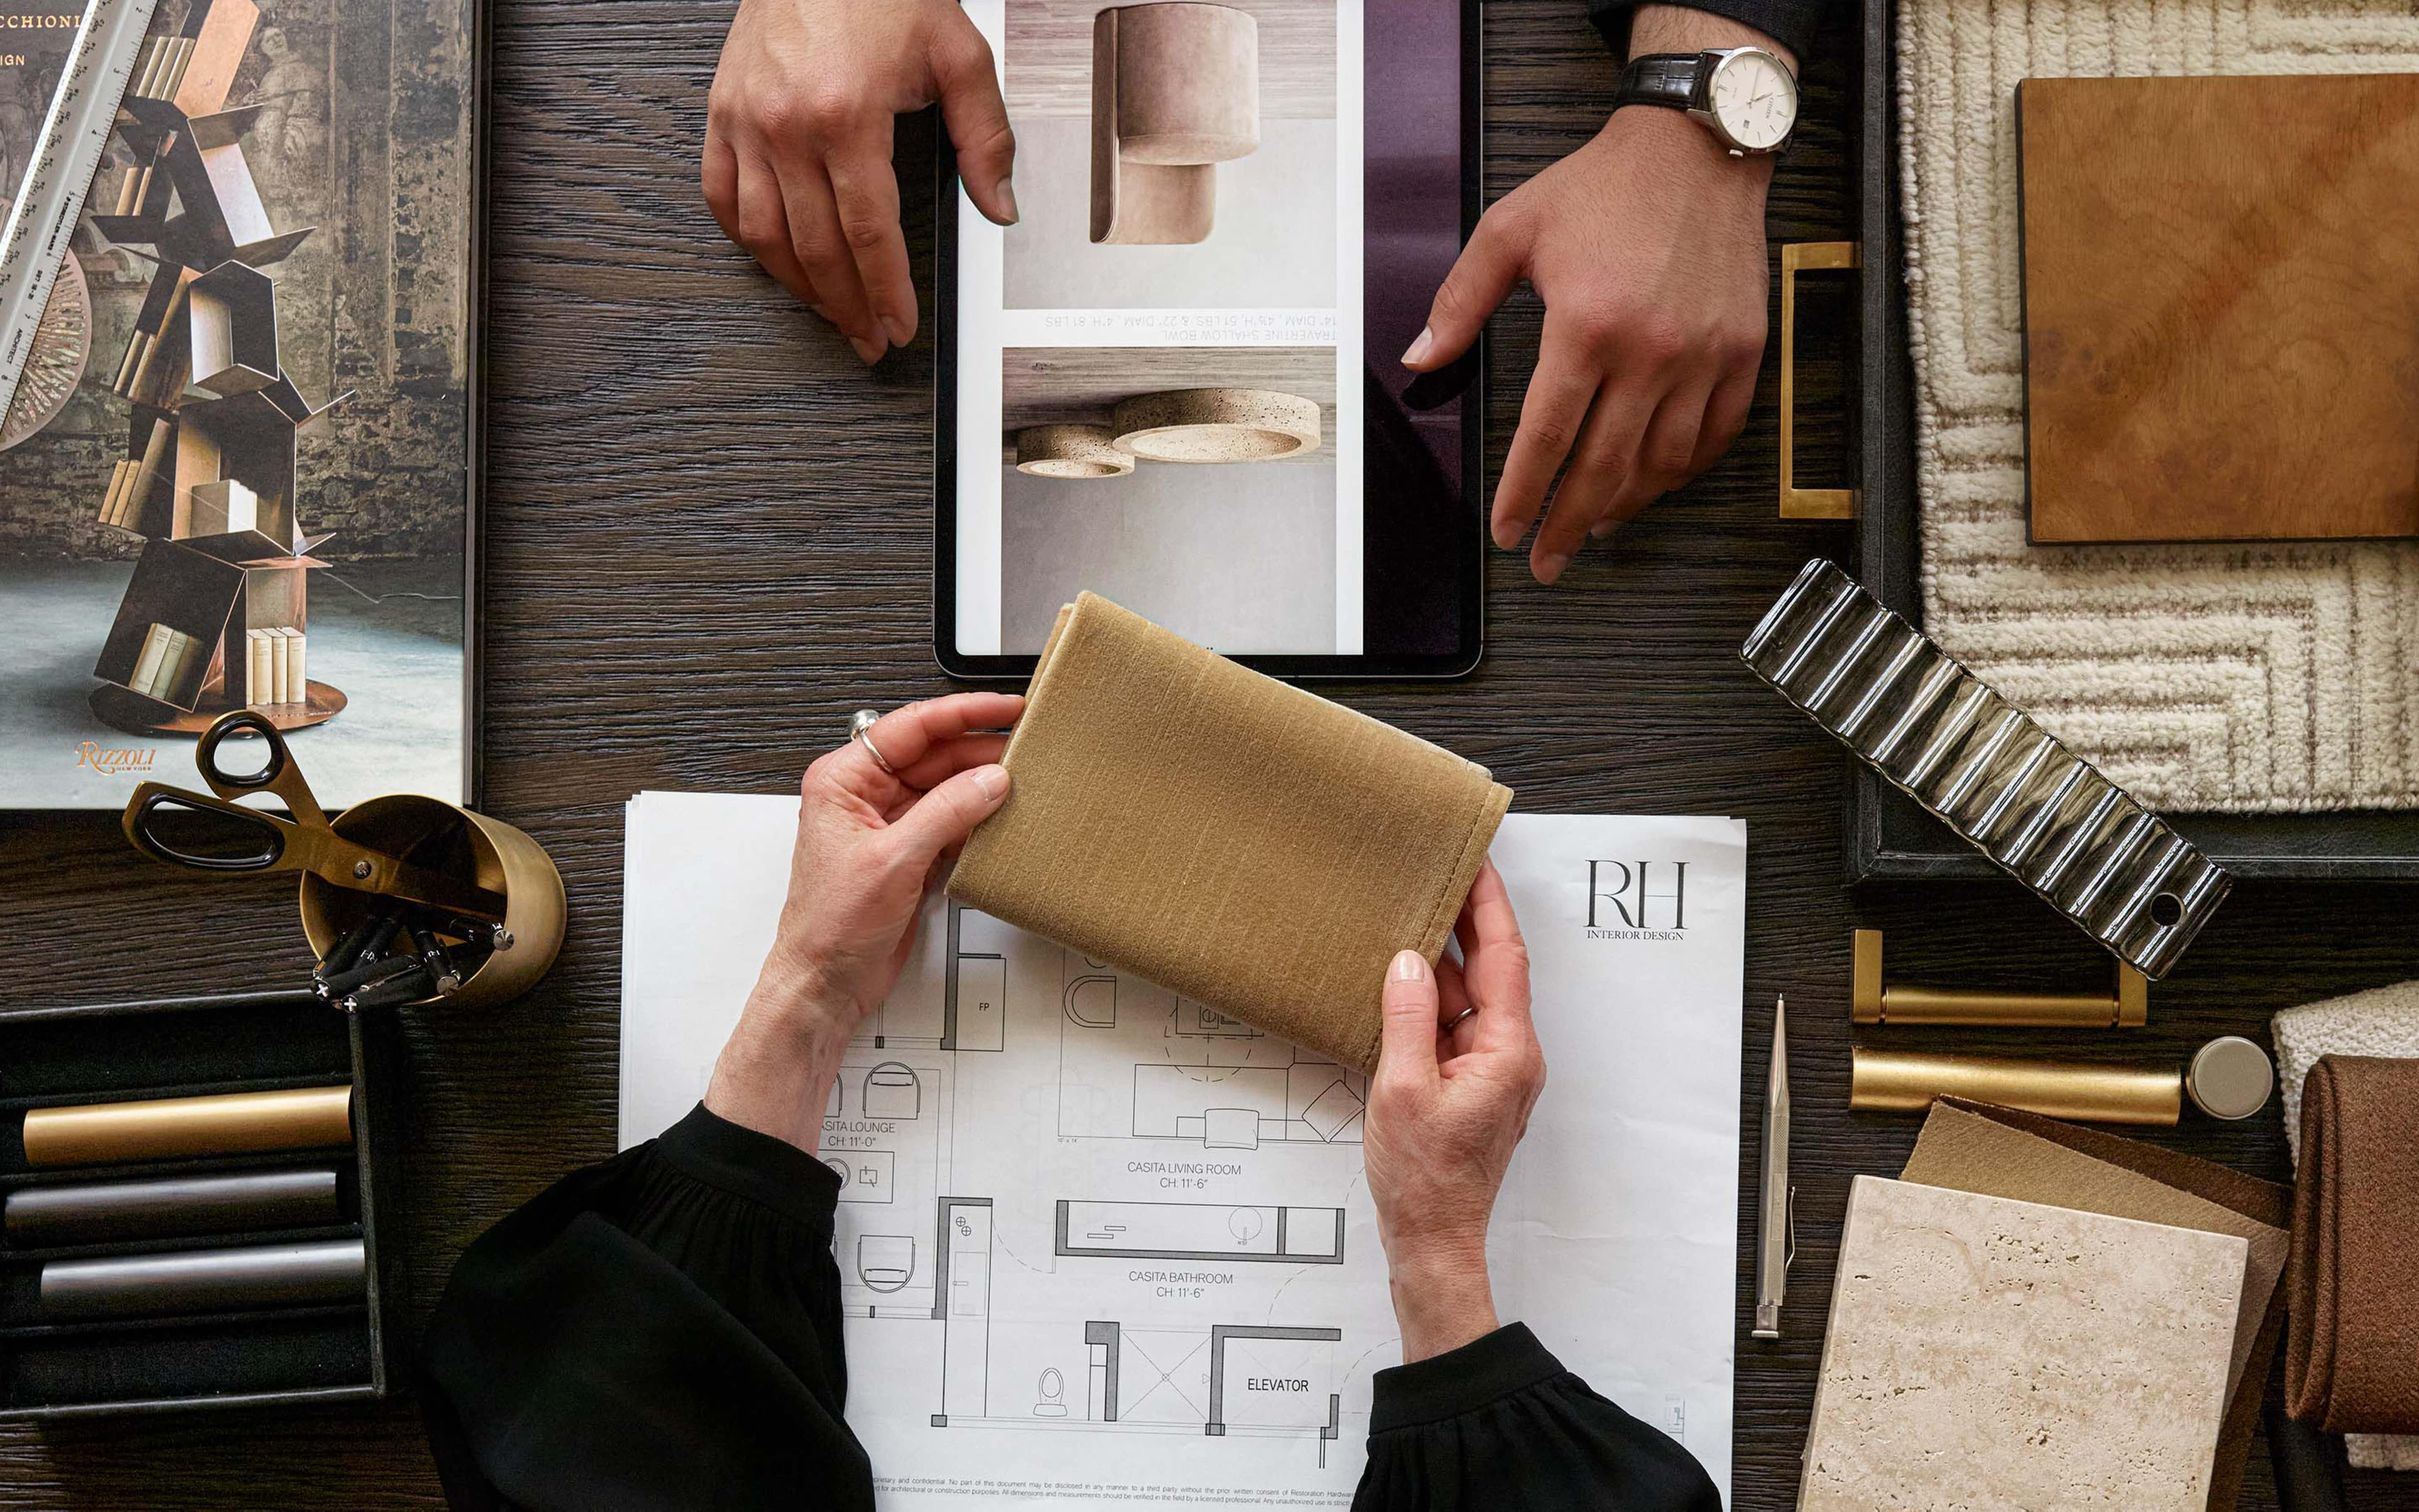
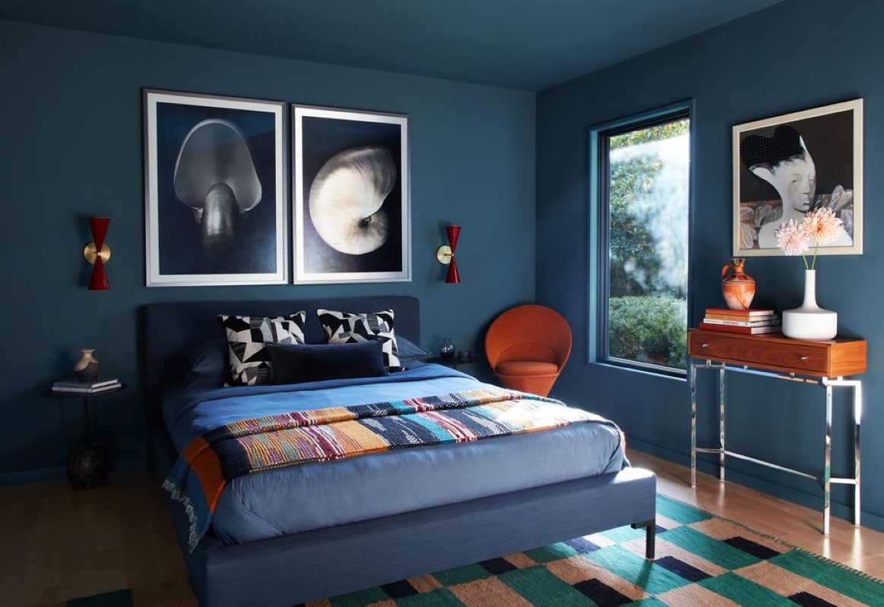
Key Services
Custom Décor Orders
Custom Décor Orders

Slide 6
Sales and Market Analysis

Slide 7

Discover Our Dynamic Workspaces

Slide 8
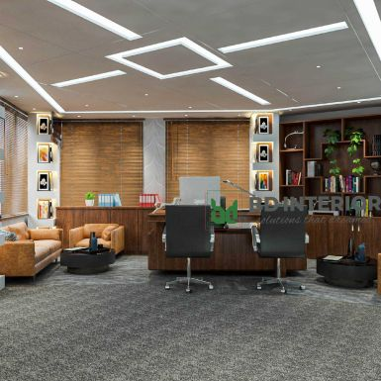
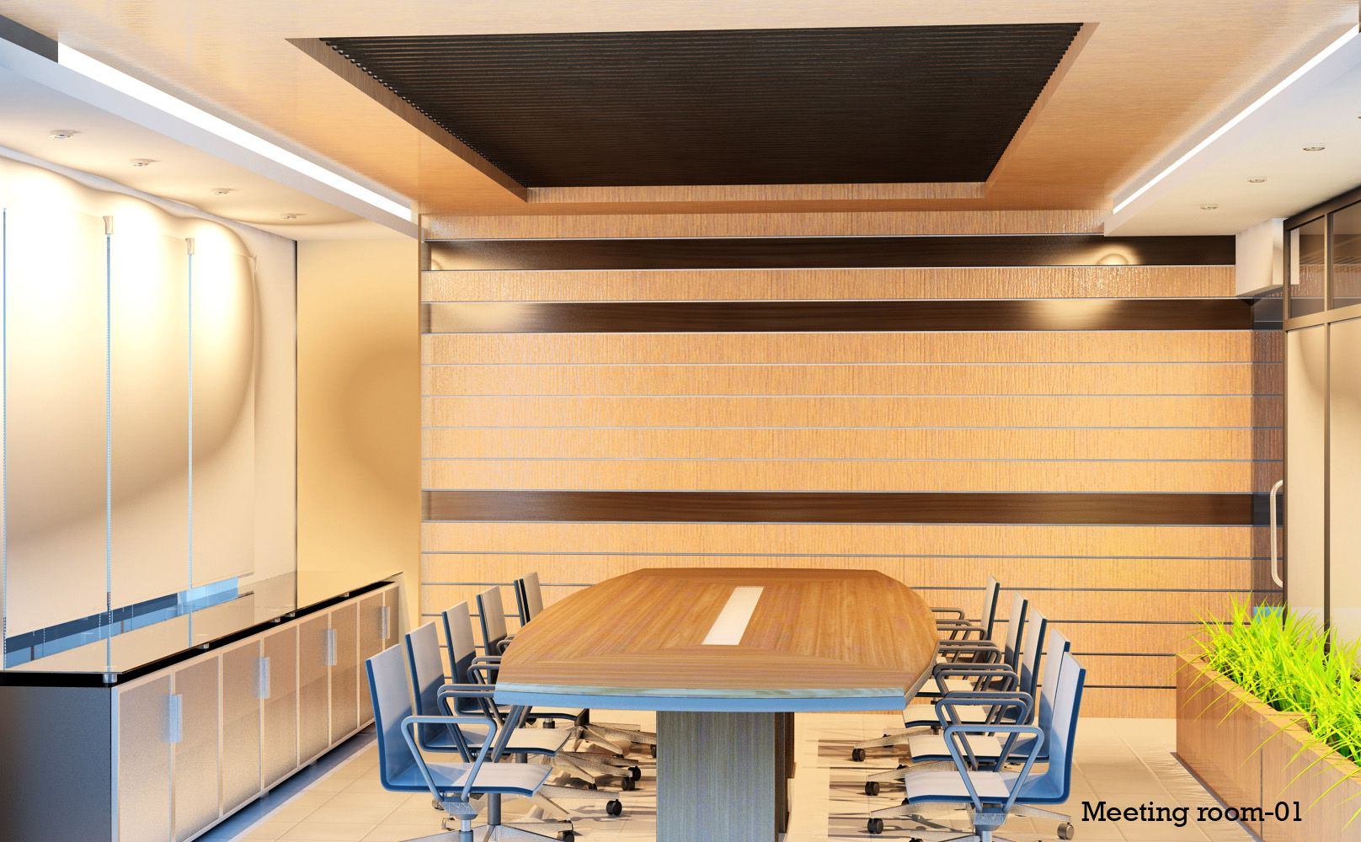
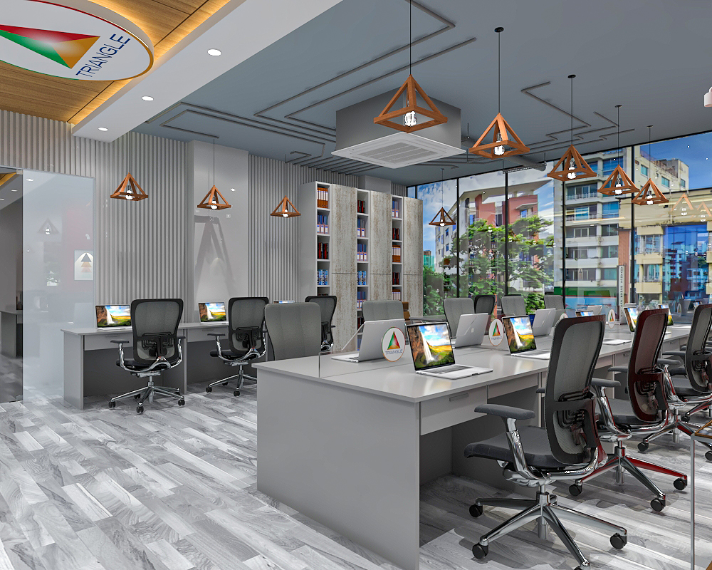



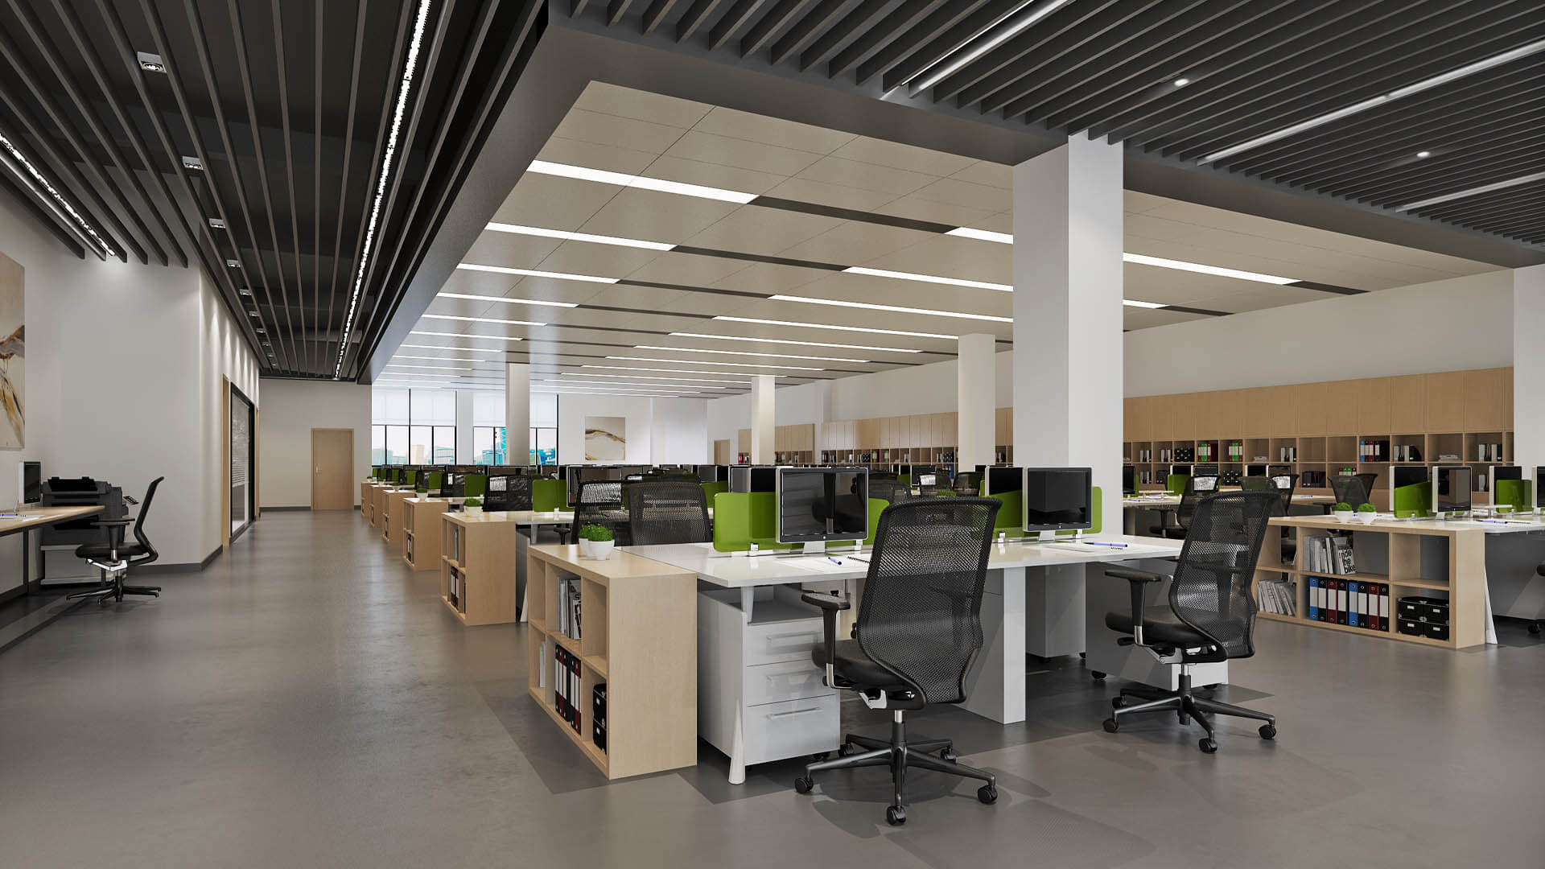
Contact Info
info@econestcreations.com
+123-456-7890
www.econestcreations.com

Slide 9
Thank You

